Slide 1

Azure Security: Diving into Azure Service Vulnerabilities

Slide 2
$ Who am i
Sahil Ojha
Penetration Tester at Eminence Ways Pvt. Ltd.
Microsoft Certified: Azure Security Engineer
Occasional Bug Bounty Hunter acknowledged by Alibaba, InDrive, Gym shark, eScan, Issabel PBX, etc.
15+ CVE registered and published for uncovering critical vulnerabilities in popular products.
https://github.com/stars/sahiloj/lists/sahil-ojha-cves

Slide 3
What is Azure ?
Azure is Microsoft’s cloud computing platform just like AWS from amazon, GCP from Google and many others.
Azure has more then 200 products and cloud services (still expanding).
Microsoft claims that 95% of fortune 500 companies uses azure cloud services.

Slide 4
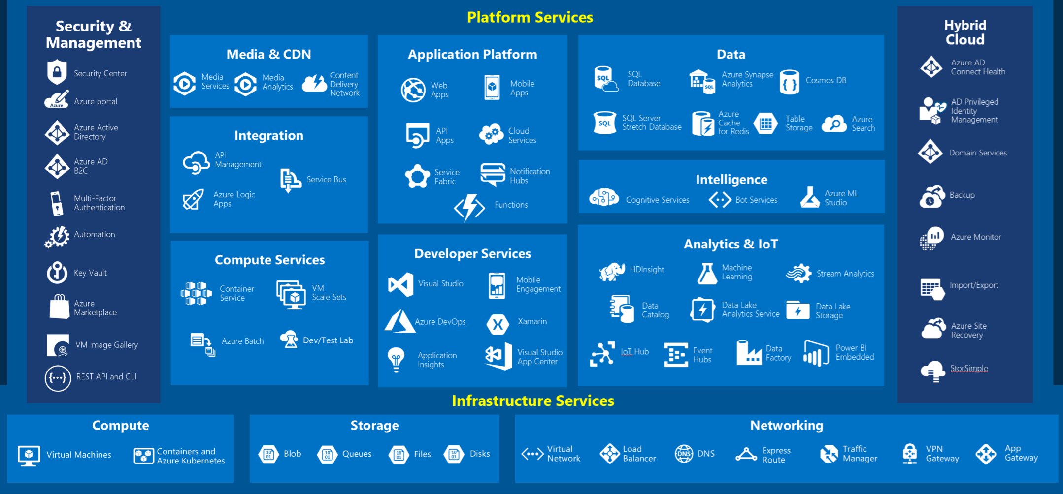
Azure Services

Slide 5
Azure Security
Password Spraying to compromise Azure AD user and Global Admins
Azure Cloud SSRF
Azure AD Misconfigurations
Blob Hunting
Subdomains Takeovers

Slide 6
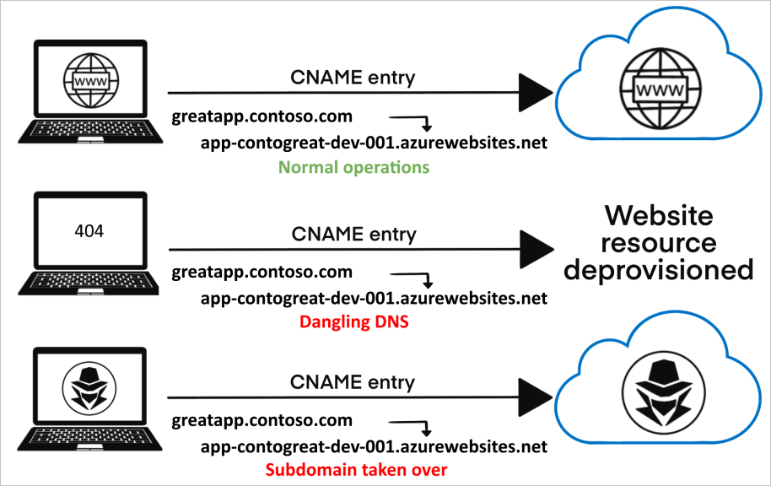
Subdomain Takeovers
Usually happens, when an attacker gain control over a subdomain of a target domain.

Slide 7
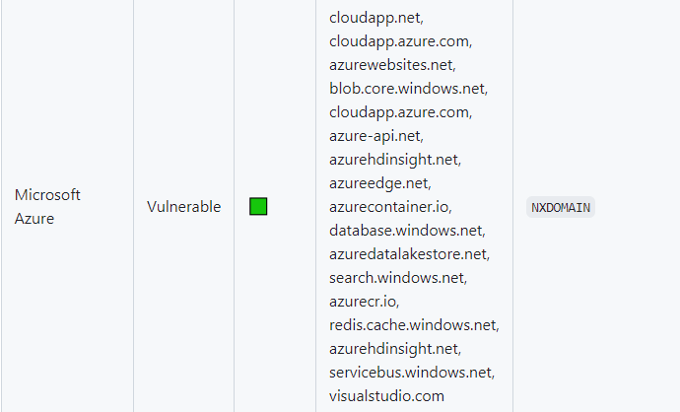
Vulnerable Services for Takeovers

Slide 8
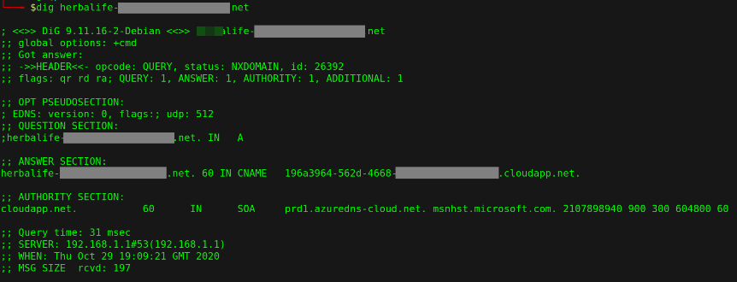
Subdomain Takeovers

Slide 9
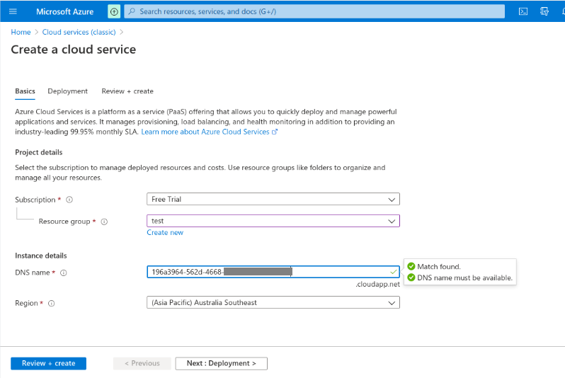
Subdomain Takeovers

Slide 10
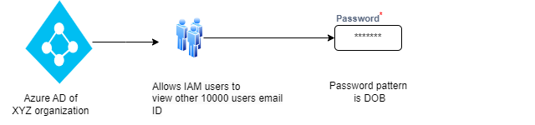
Password Spraying to compromise Azure AD user and Global Admins
Scenario: Any user in domain can dump all the Azure AD users and know some password patterns.

Slide 11
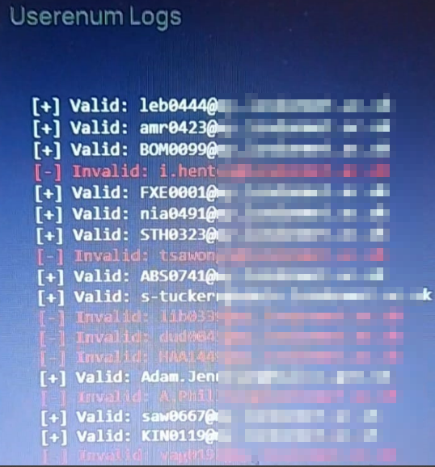
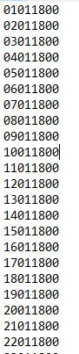
Password Spraying to compromise Azure AD user and Global Admins
Performed password spray with tools like vajra and got access to other IAM users accounts.

Slide 12
Mitigation
Enforcing a group policy to check for failed authentication attempts & restrict their authentication for certain hours.
Enforcing MFA to IAM users.

Slide 13
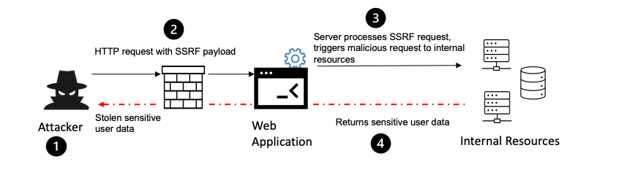
Azure Cloud SSRF
SSRF(Server Side Request Forgery)
A single vulnerable function or API calls in codebase can introduce SSRF that could compromise your cloud infrastructures.
GET /index.php?url=http://169.254.169.254/metadata/

Slide 14
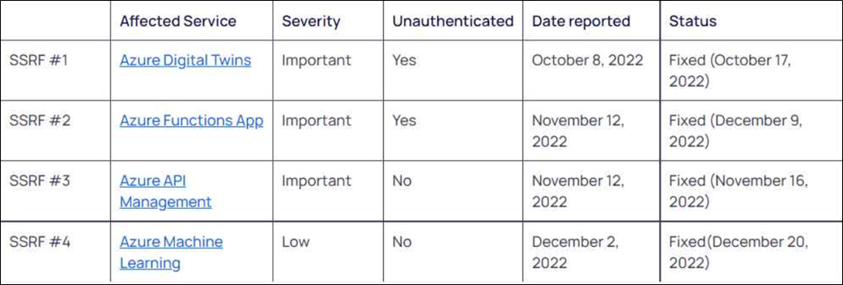
Azure Cloud SSRF
Discovered by ORCA security
1. Unauthenticated SSRF on Azure Digital Twins Explorer 2. Unauthenticated SSRF on Azure Functions 3. Authenticated SSRF on Azure API Management Service 4. Authenticated SSRF on Azure Machine Learning Service

Slide 15
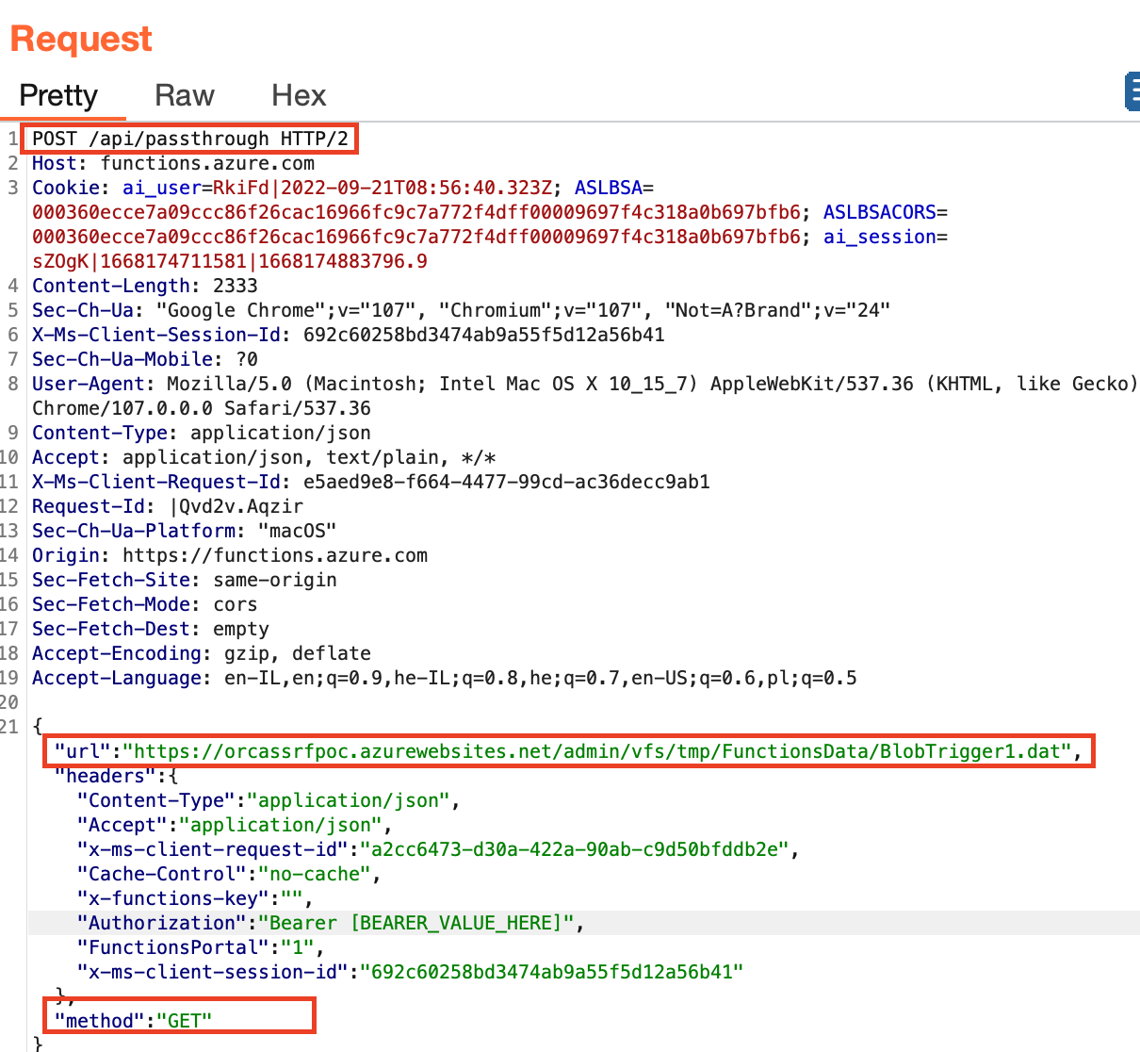
Azure Cloud SSRF

Slide 16
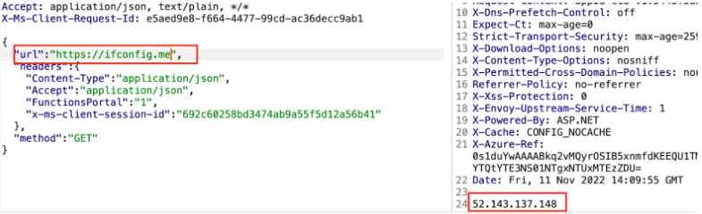
Azure Cloud SSRF

Slide 17
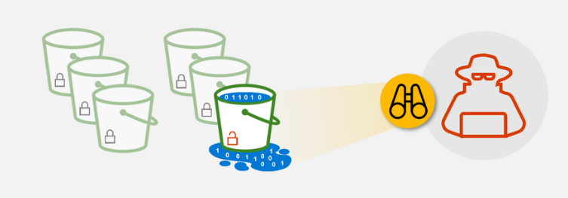
Blob Hunting
Many organizations exposes millions of sensitive files via publicly opened blobs.
Blob storage when configured with anonymous read access leaks sensitive data.

Slide 18
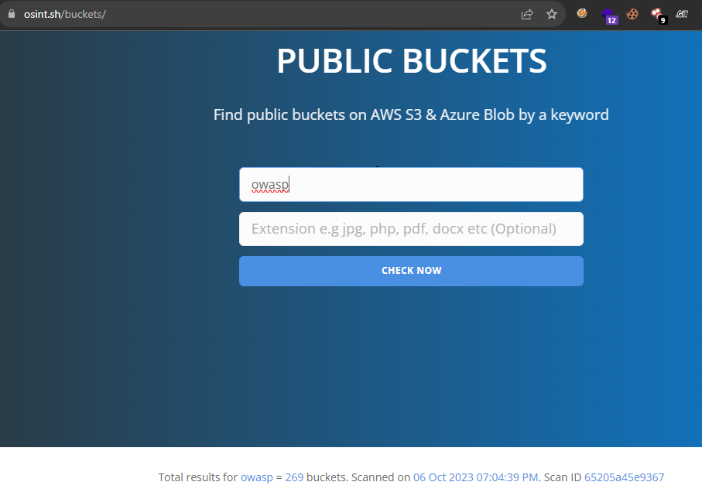
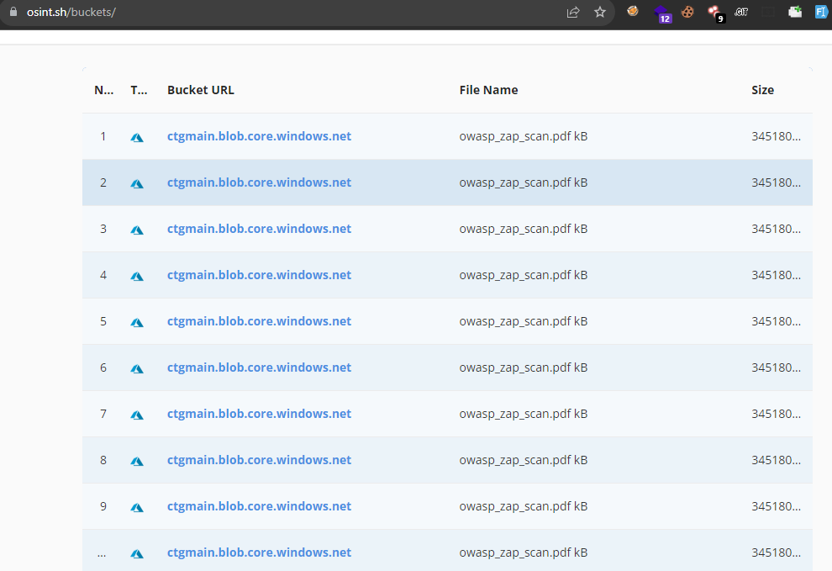
Blob Hunting

Slide 19
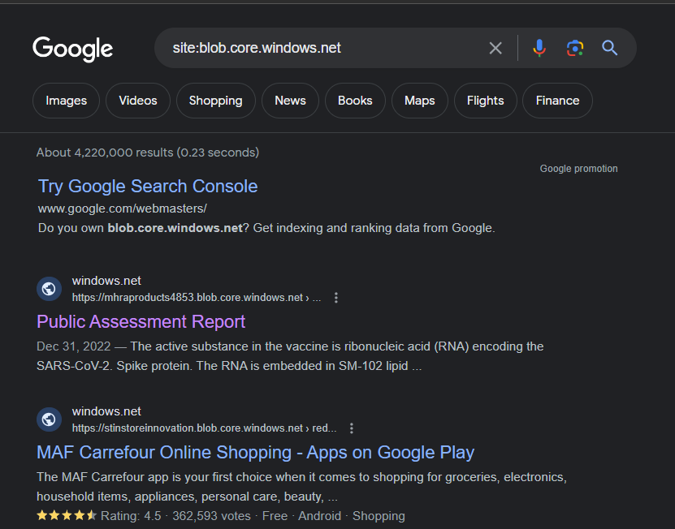
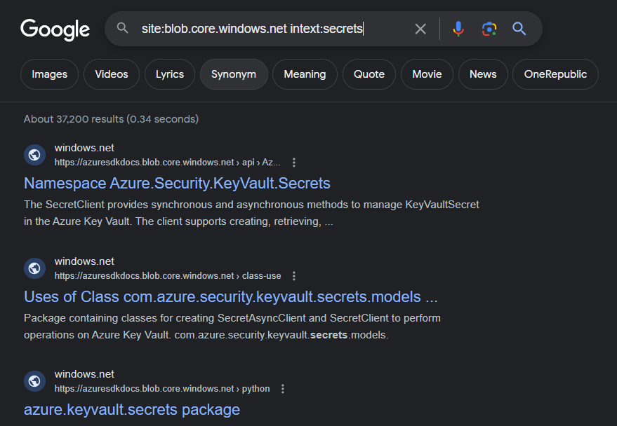
Blob Hunting

Slide 20
Azure AD
Azure Active Directory (Azure AD or AAD) is Microsoft’s cloud based identity and access management service.
Azure AD can be used to access both:
- External resources like Azure portals, office 365, etc.
- Internal resources like on-premise applications.
Azure AD and it’s security is itself huge but let’s get some insight on this too.

Slide 21
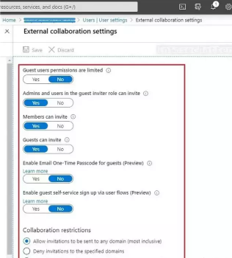
Azure AD Misconfiguration
Insecure Guest User Settings

Slide 22
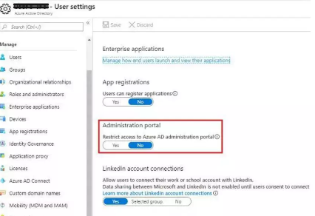
Azure AD Misconfiguration
Unrestricted Access to Azure AD Management Portal

Slide 23
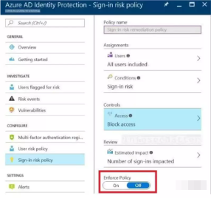
Azure AD Misconfiguration
Azure Identity Protection features is disabled

Slide 24
Ending Note
There are so many other configuration that can go wrong in Azure AD to introduce threats at different user and tenant levels.
https://learn.microsoft.com/en-us/security/benchmark/azure/baselines/aad-security-baseline

Slide 25
Any Questions ?

Slide 26



Thankyou
https://github.com/stars/sahiloj/lists/sahil-ojha-cves
https://sahiloj.medium.com
https://twitter.com/SahilOj

